Slide 1
Data Storage Solutions for Data Analytics B9DA111_2122_TMD3 Group B CA
Presented By:
Rajendra Kumar - 10605069
Srinivasarao Thotakura - 10604765
Saima Saleem - 10603701
Presented To:
Bernie Lydon

Slide 2
DATA WAREHOUSE DESIGN FOR BIKE MART
Introduction
Bike-Mart has different stores across the country and where daily sales take place for various products. Top management people are facing difficulty while making any decisions since information is distributed in various locations. So, requirements raised to centralized the information so that business insights can be generated from sales data.
REASONS FOR SELECTING THE SUBJECT AREA AND DATA
Following are the reasons for choosing the dataset.
Bike-Mart has multiple stores in various locations.
It has multiple related entities which are suitable to generate information about associated entities.
Entities are very much similar to real time objects / tables in relational databases.
It meets almost all the criteria for this task.

Slide 3
DATA WAREHOUSE DESIGN FOR BIKE MART
VISION AND GOALS
Goal: The goal of this work is to consolidate the operational data into a data warehouse using different tools/techniques to provide business insights of data for business stakeholders to make informed decisions to grow their business.
Vision: Create business intelligence from distributed information.
KEY STAKEHOLDERS
Business Owner/ Users
Finance department users

Slide 4
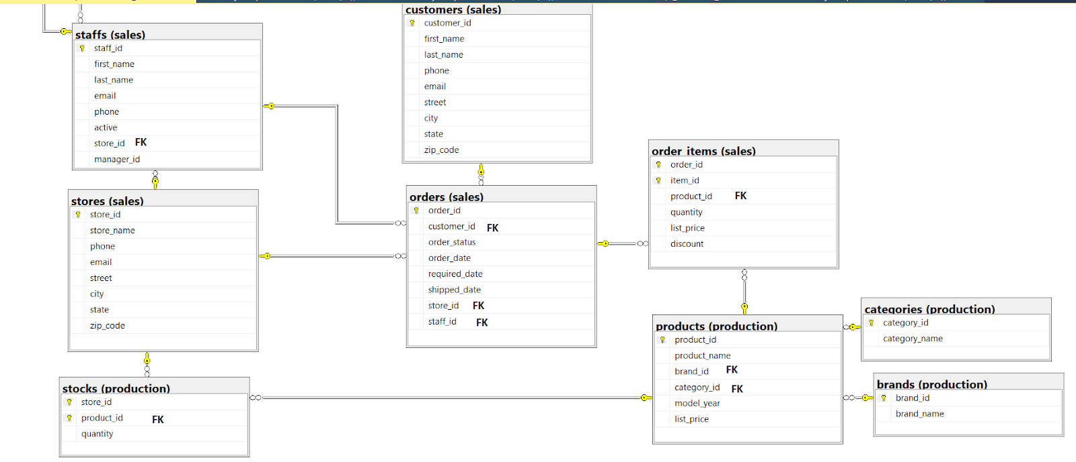
Entity Relationship Diagram - BikeStore

Slide 5
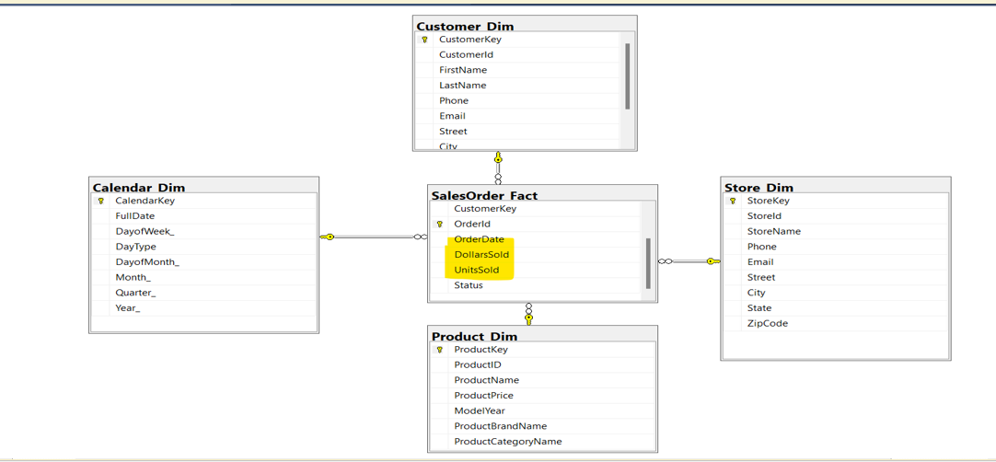
Star Schema

Slide 6
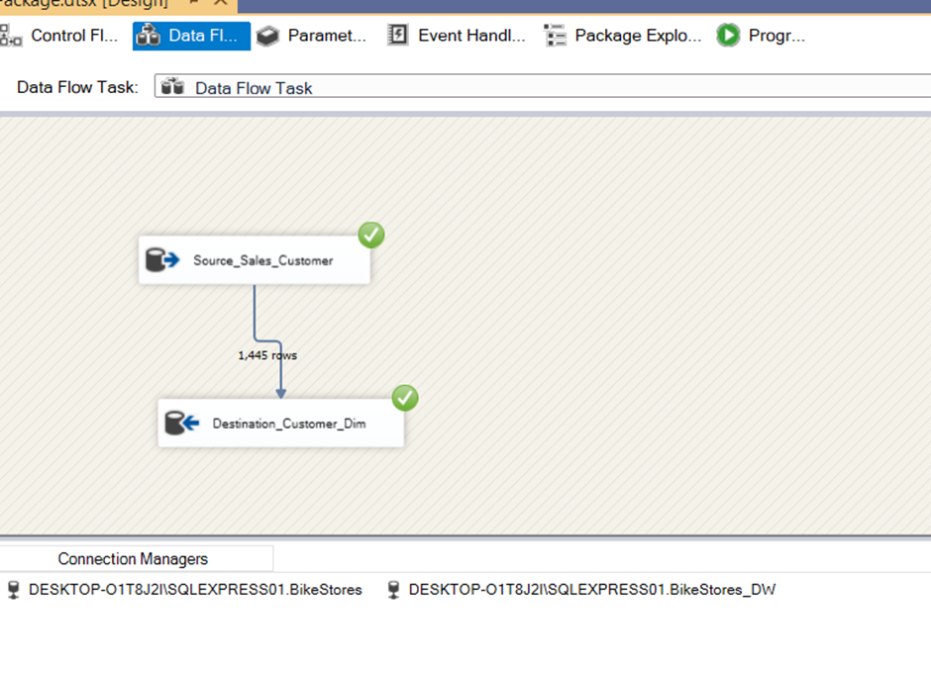
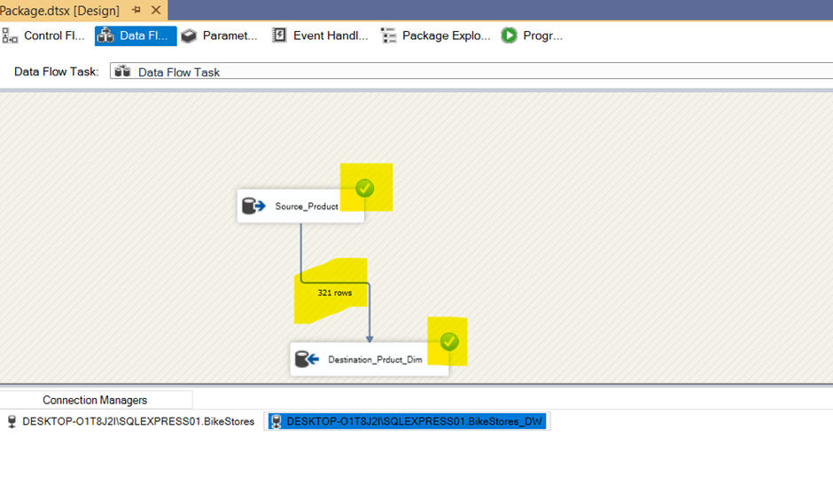
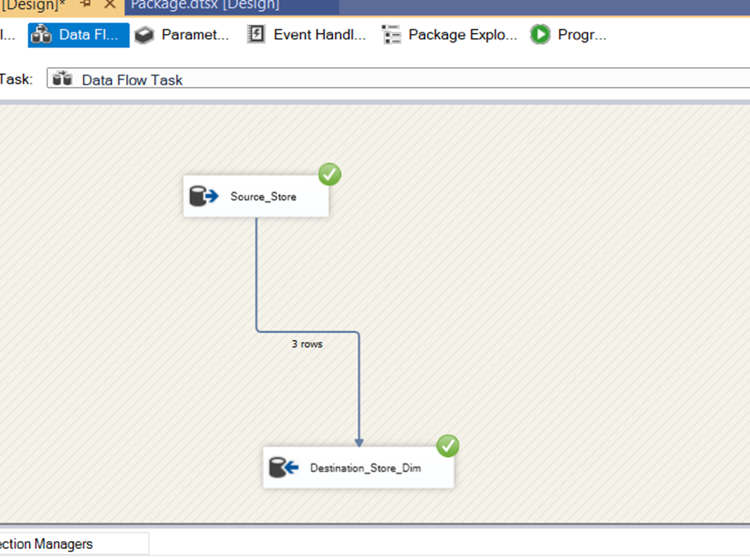
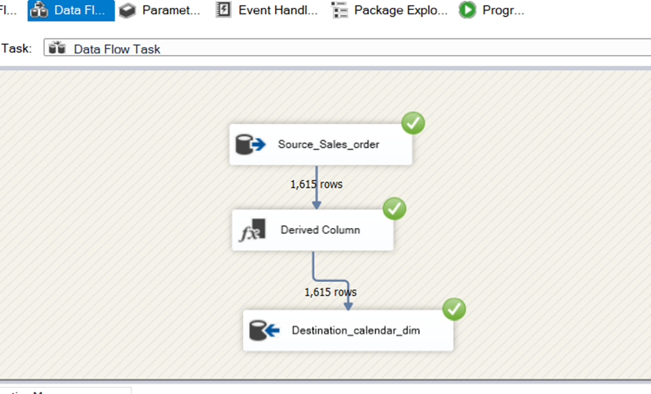
Populate Customer dimension table(ETL):
Populate Store dimension table:
Populate Calendar dimension table:

Slide 7
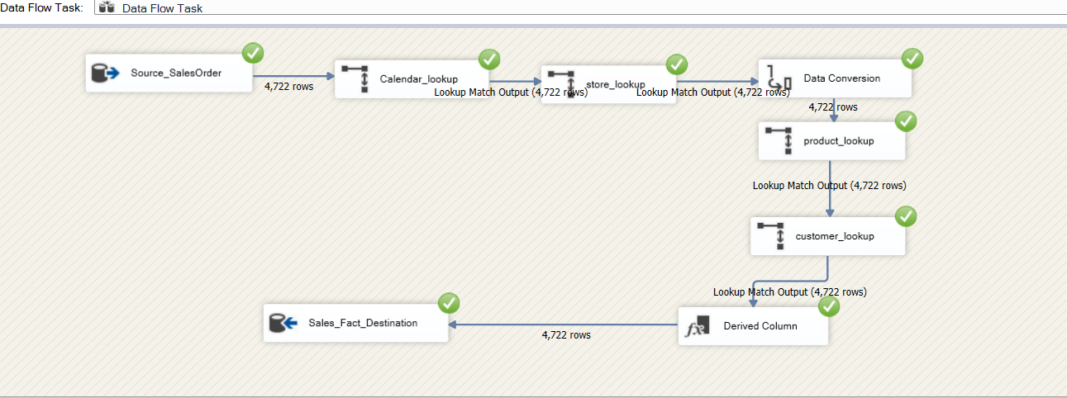
Fact Table Population
Populate Calendar dimension table:

Slide 8
Fact Table Population
Populate Calendar dimension table:

Slide 9
Reports

Slide 10
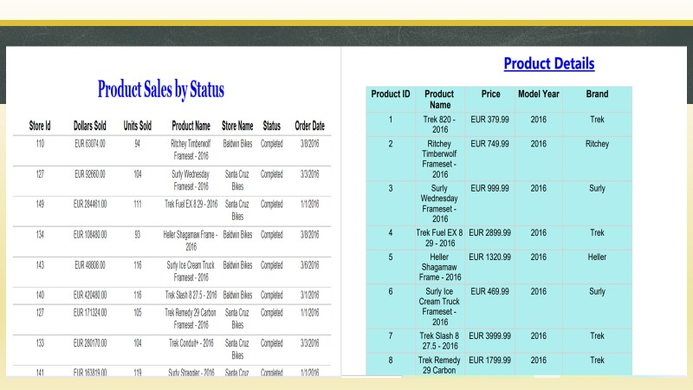

Slide 11
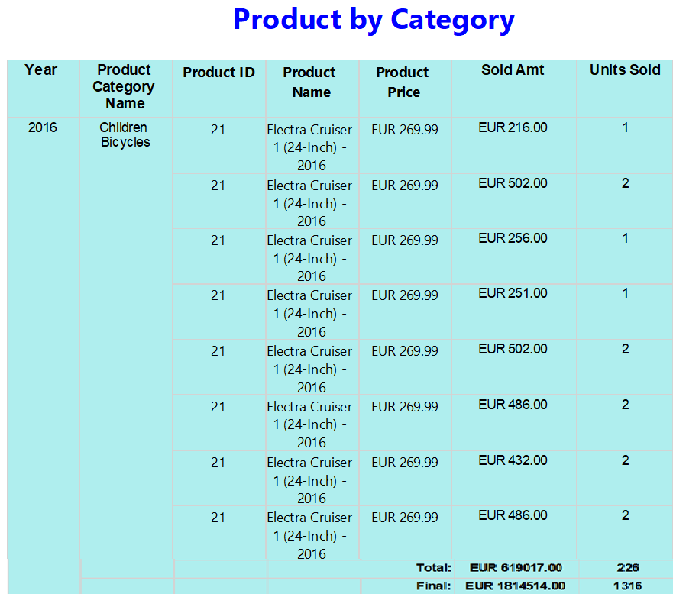
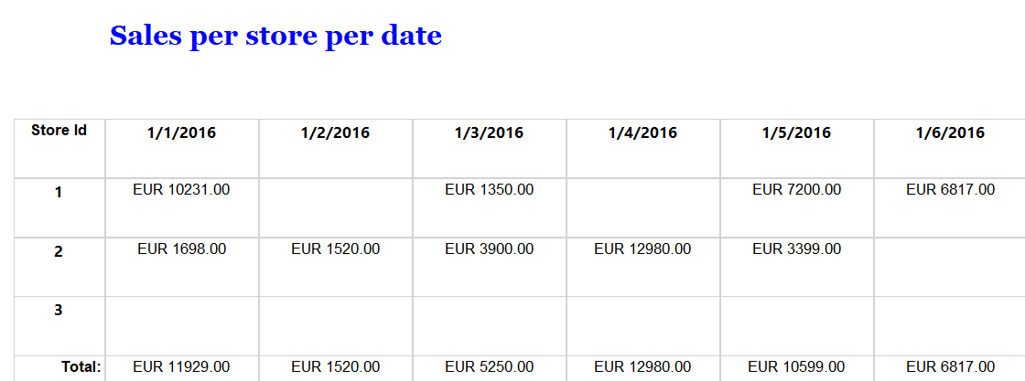

Slide 12
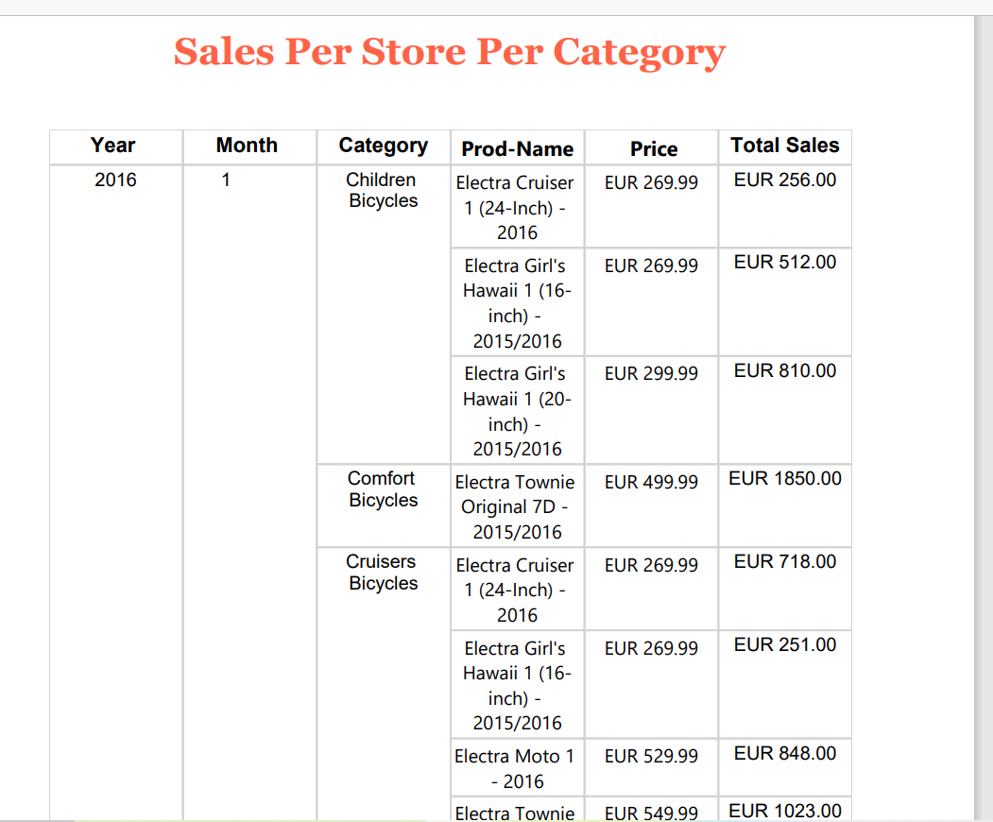
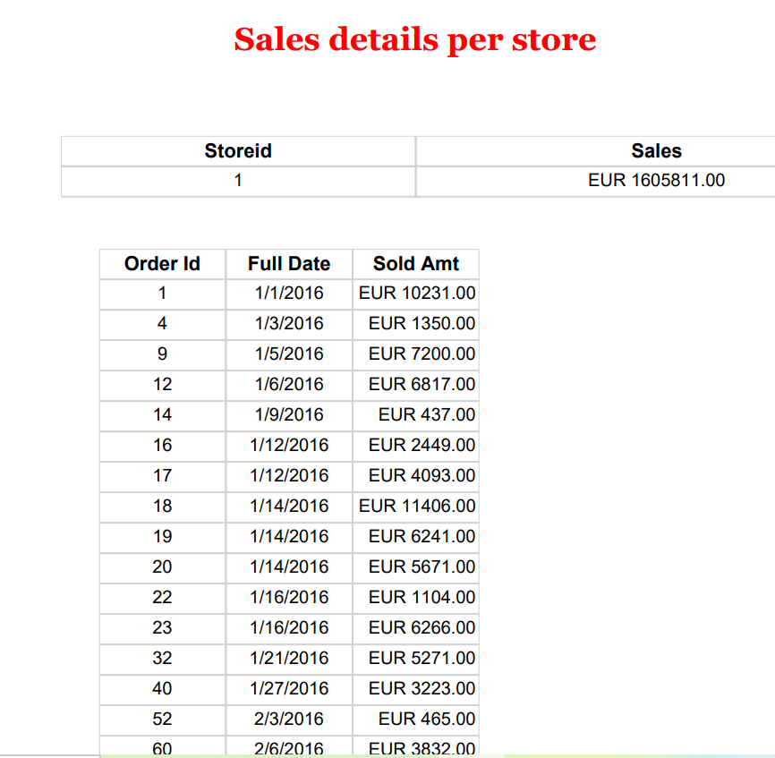

Slide 13
Tableau

Slide 14
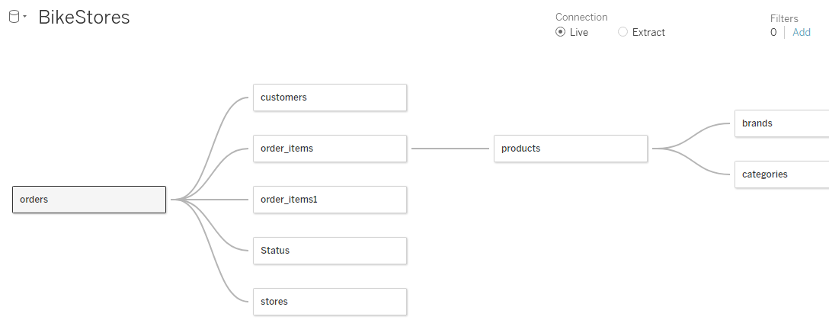
Data Visualization Using Tableau
Connect to Database using Microsoft SQL Server in Tableau. Initially map all the relationships to extract the data

Slide 15
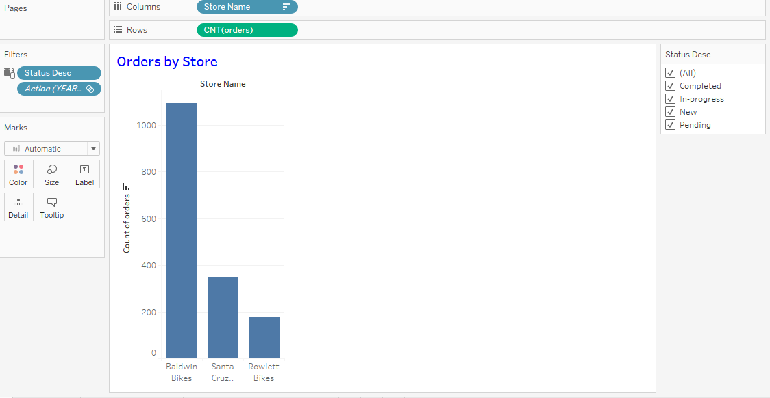
Orders by Store

Slide 16
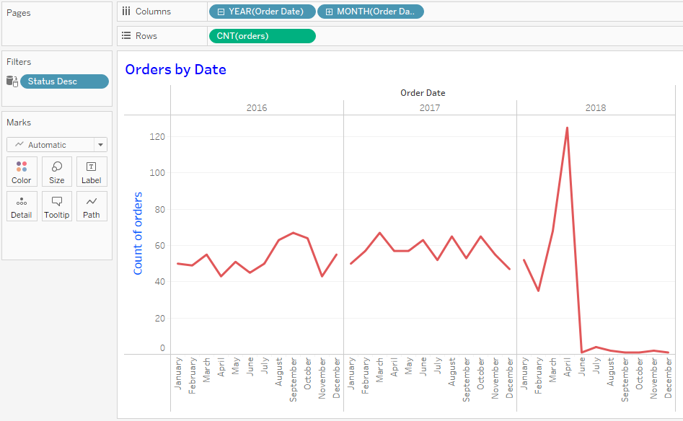
Orders by Date

Slide 17
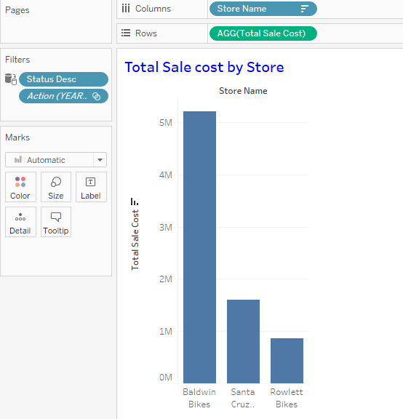
Total Cost of Sales by Store

Slide 18
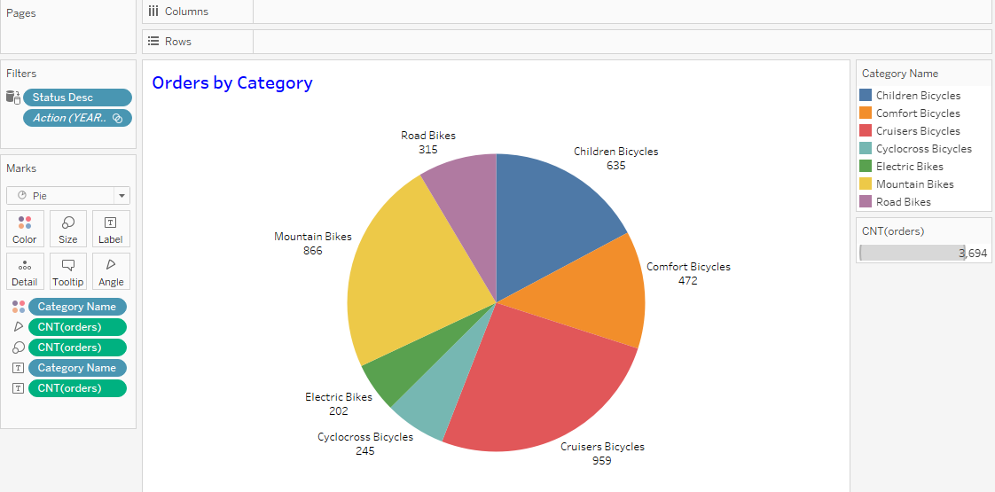
Orders by Category

Slide 19
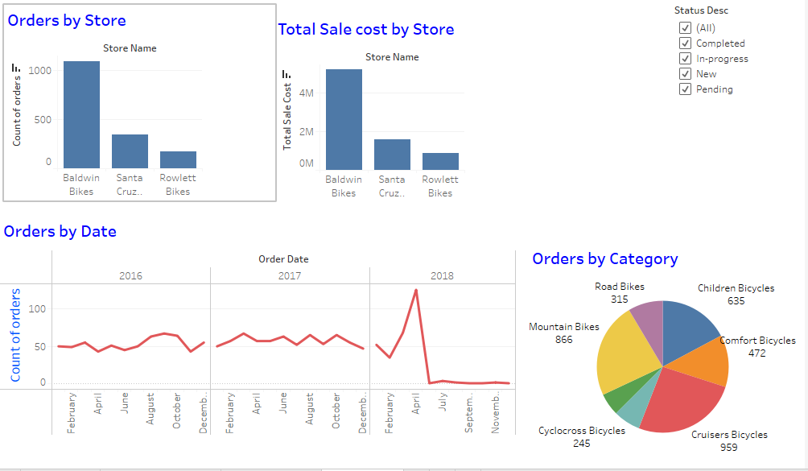
Bike Sales Dashboard

Slide 20
Neo4J
And Its Comparison With MS SQL

Slide 21
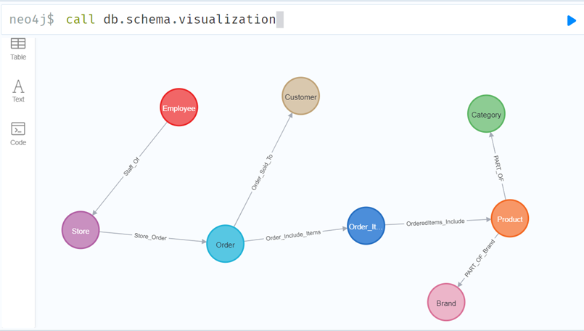
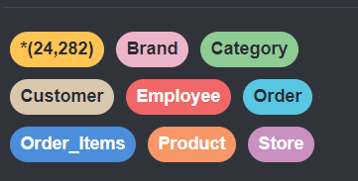
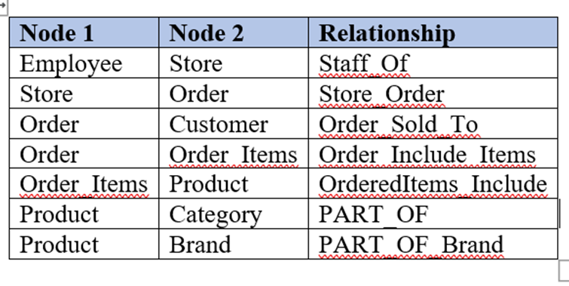

Slide 22
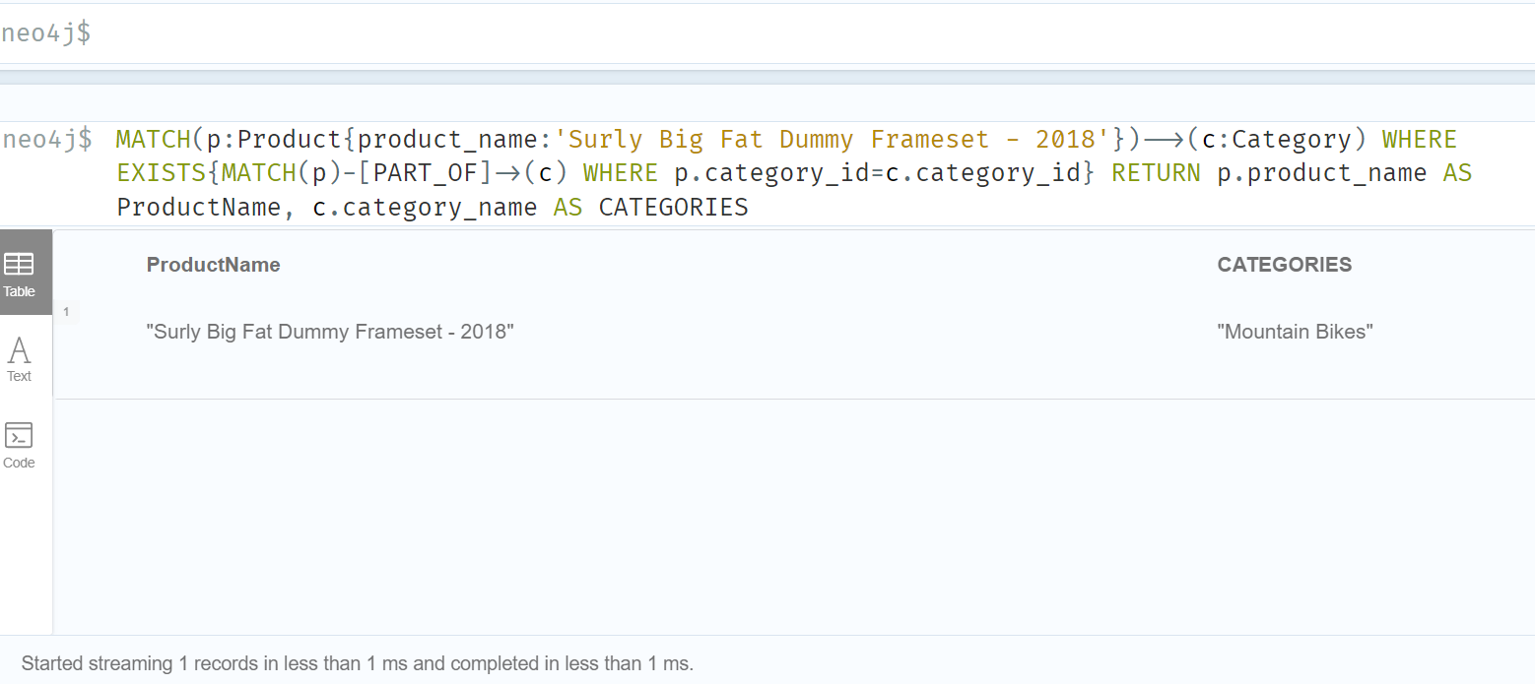
Neo4J Query 1
To know the category of a product for example “Surly Big Fat Dummy Frameset-2018”

Slide 23
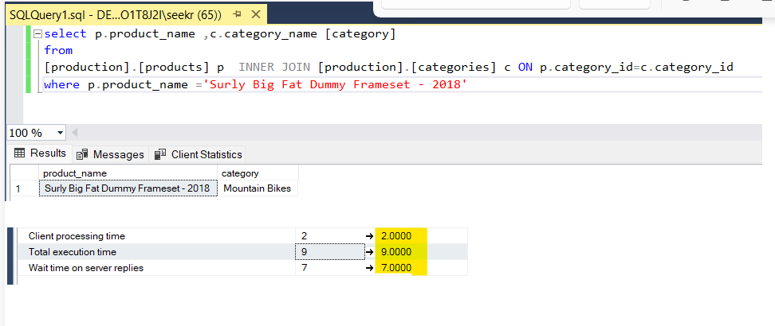
MS SQL Query 1
To know the category of a product for example “Surly Big Fat Dummy Frameset-2018”

Slide 24
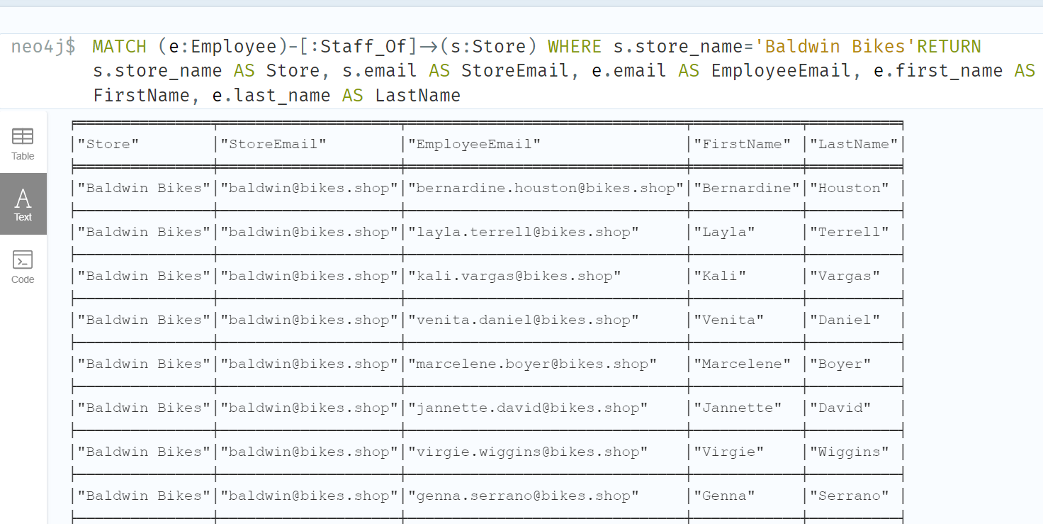
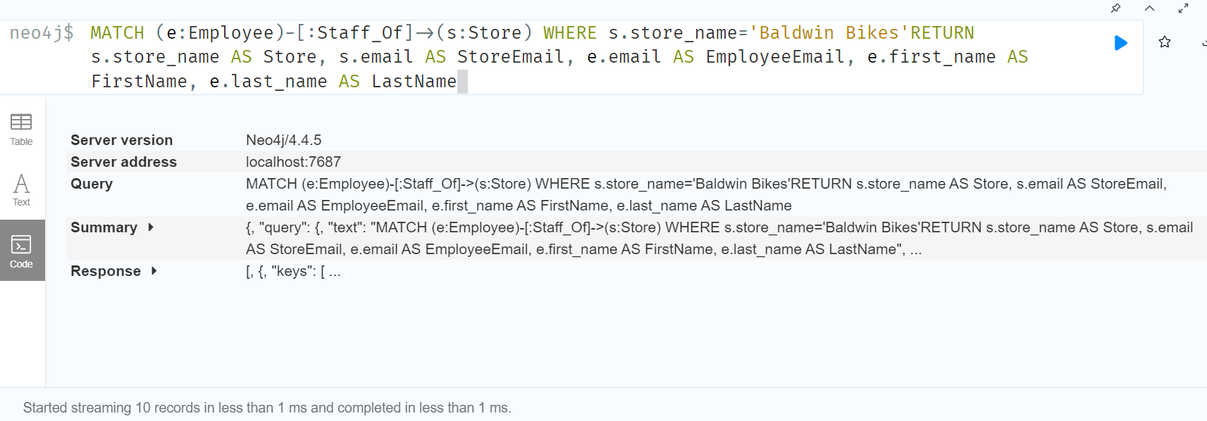
Neo4J Query 2
To retrieve the information about the staff working at one of the stores e.g. ‘Baldmin Bikes’

Slide 25
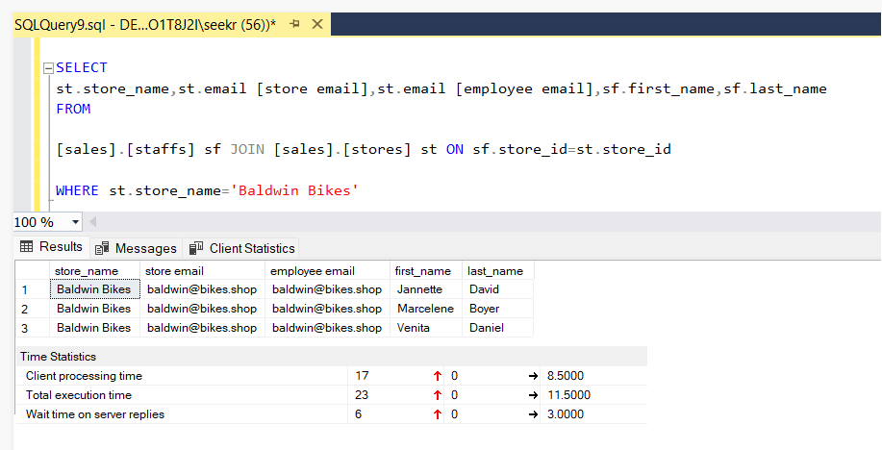
MS SQL Query 2
To retrieve the information about the staff working at one of the stores e.g. ‘Baldmin Bikes’

Slide 26
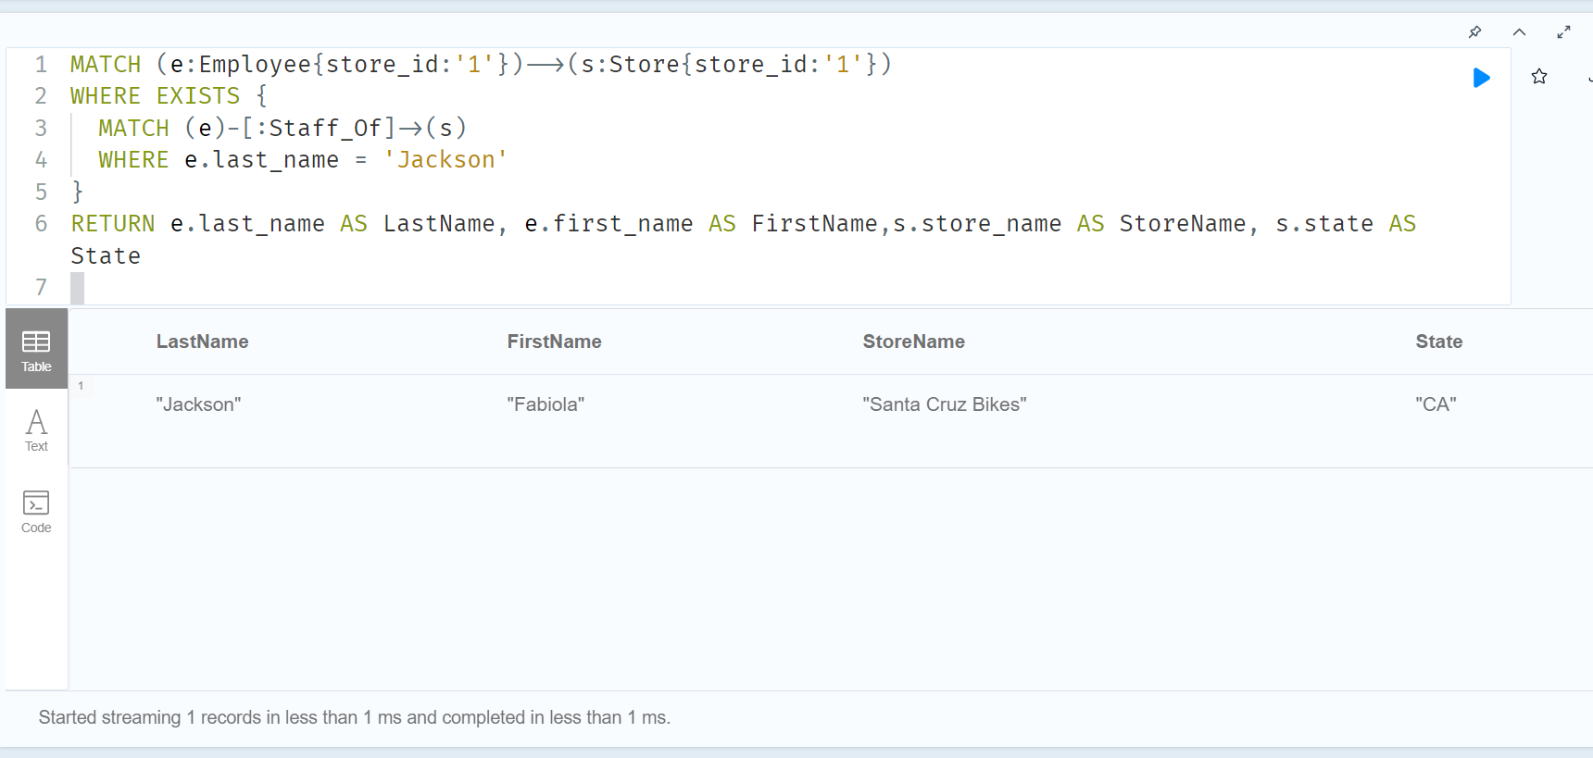
Neo4J Query 3
To retrieve the information about employee with last_name e.g. “Jackson” working at a e.g. store Id ‘1’

Slide 27
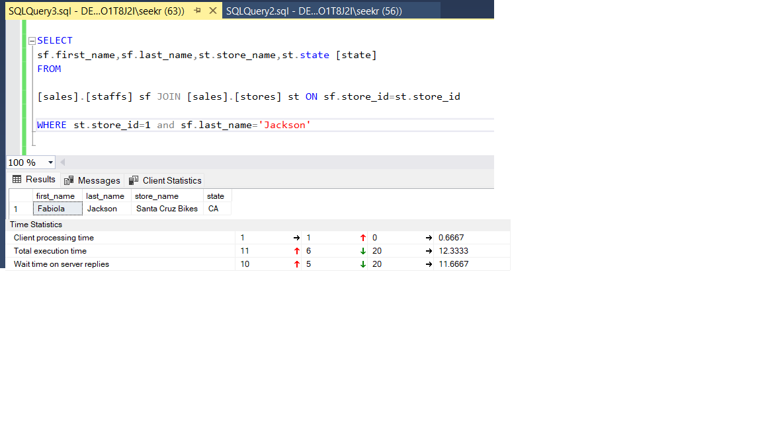
MS SQL Query 3
To retrieve the information about employee with last_name e.g. “Jackson” working at a e.g.store Id ‘1’

Slide 28
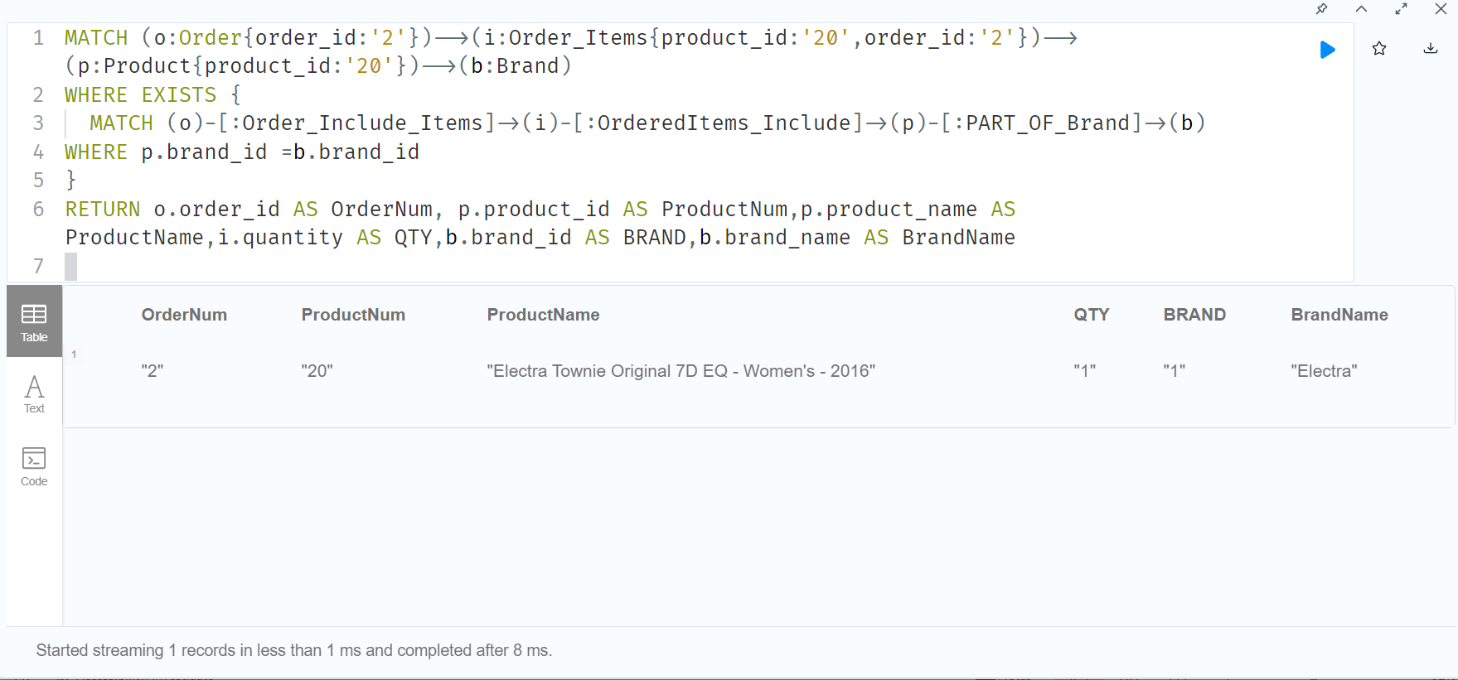
Neo4J Query 4
To retrieve the information about an order_id e.g. ‘2’, product_id e.g. ‘20’ including brand

Slide 29
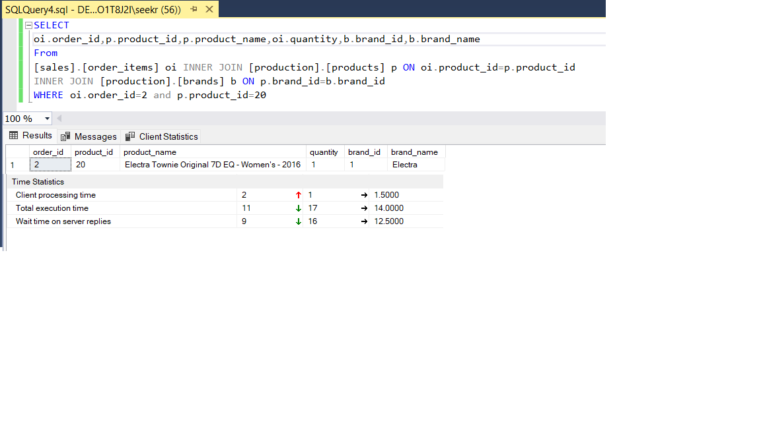
MS SQL Query 4
o retrieve the information about an order_id e.g. ‘2’, product_id e.g. ‘20’ including brand

Slide 30
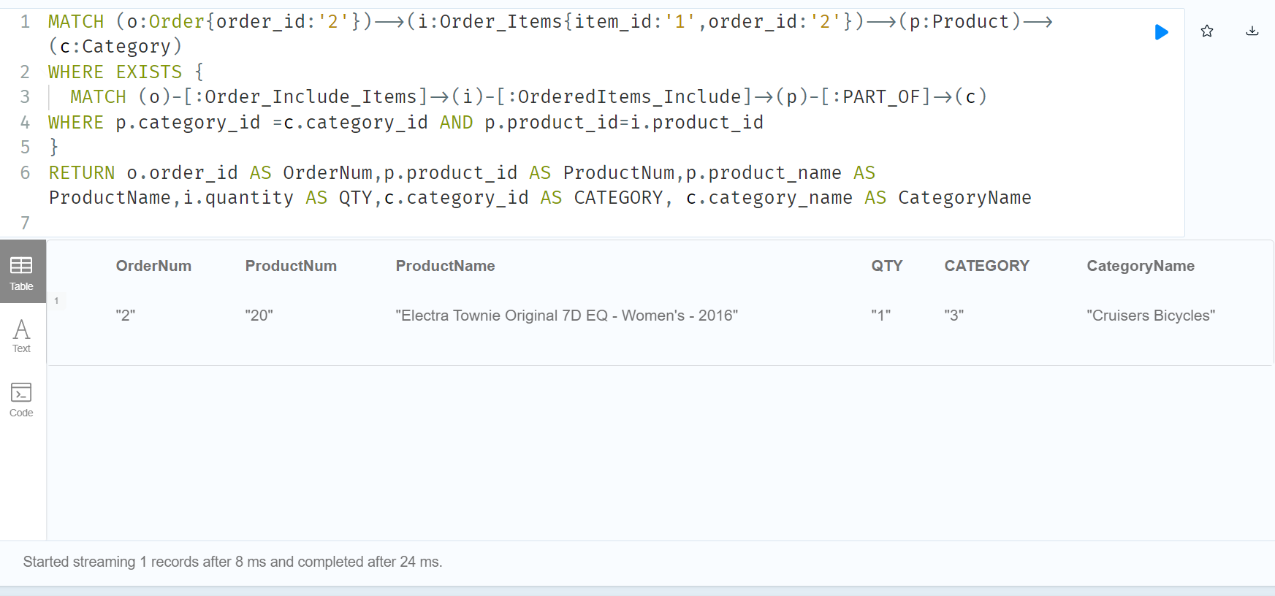
Neo4J Query 5
To retrieve the information about order_id e.g. ‘2’, product_id e.g. ‘20’ including category

Slide 31
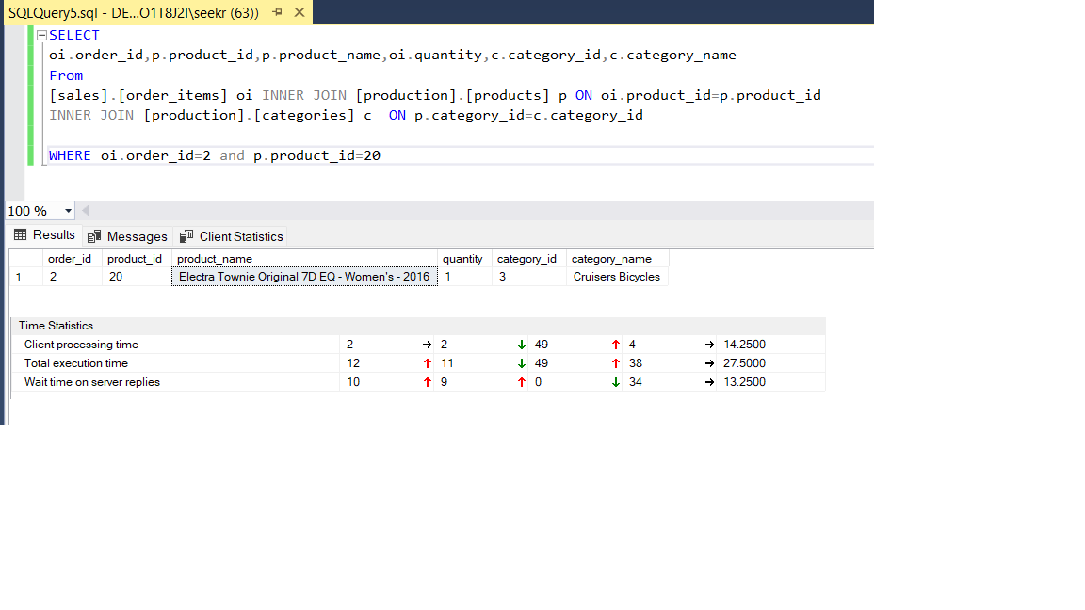
MS SQL Query 5
To retrieve the information about order_id e.g. ‘2’, product_id e.g. ‘20’ including category

Slide 32
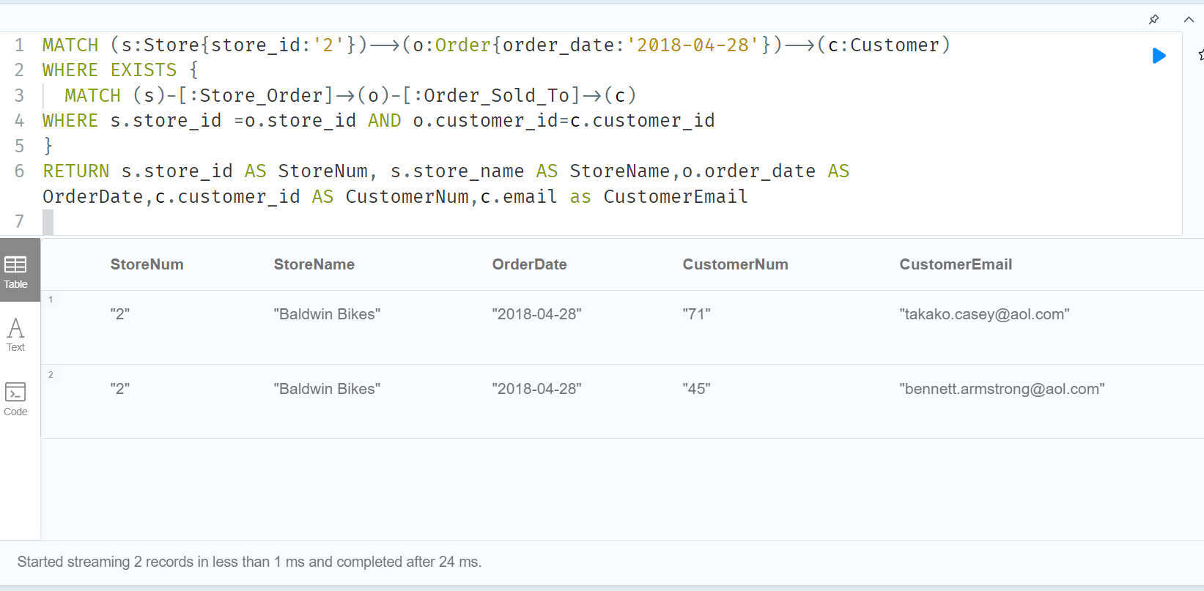
Neo4J Query 6
To retrieve the information about a store_id e.g. ‘2’, order_date e.g. ‘2018-04-28’ about store name, order date, and customer’s email.

Slide 33
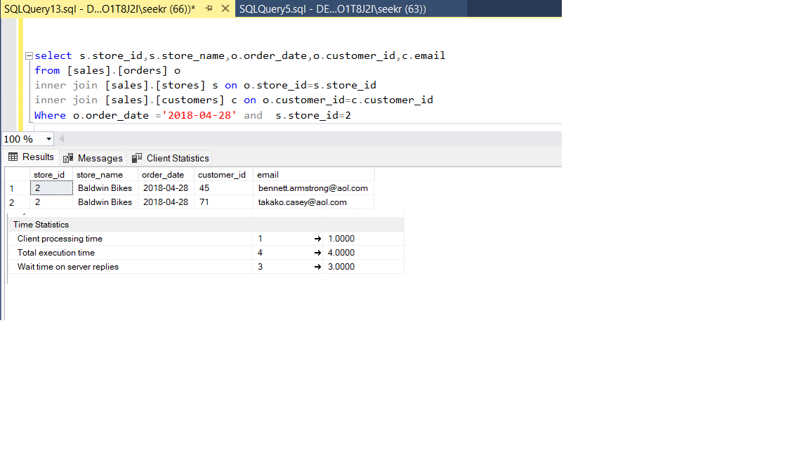
MS SQL Query 6
To retrieve the information about a store_id e.g. ‘2’, order_date e.g. ‘2018-04-28’ about store name, order date, and customer’s email.

Slide 34
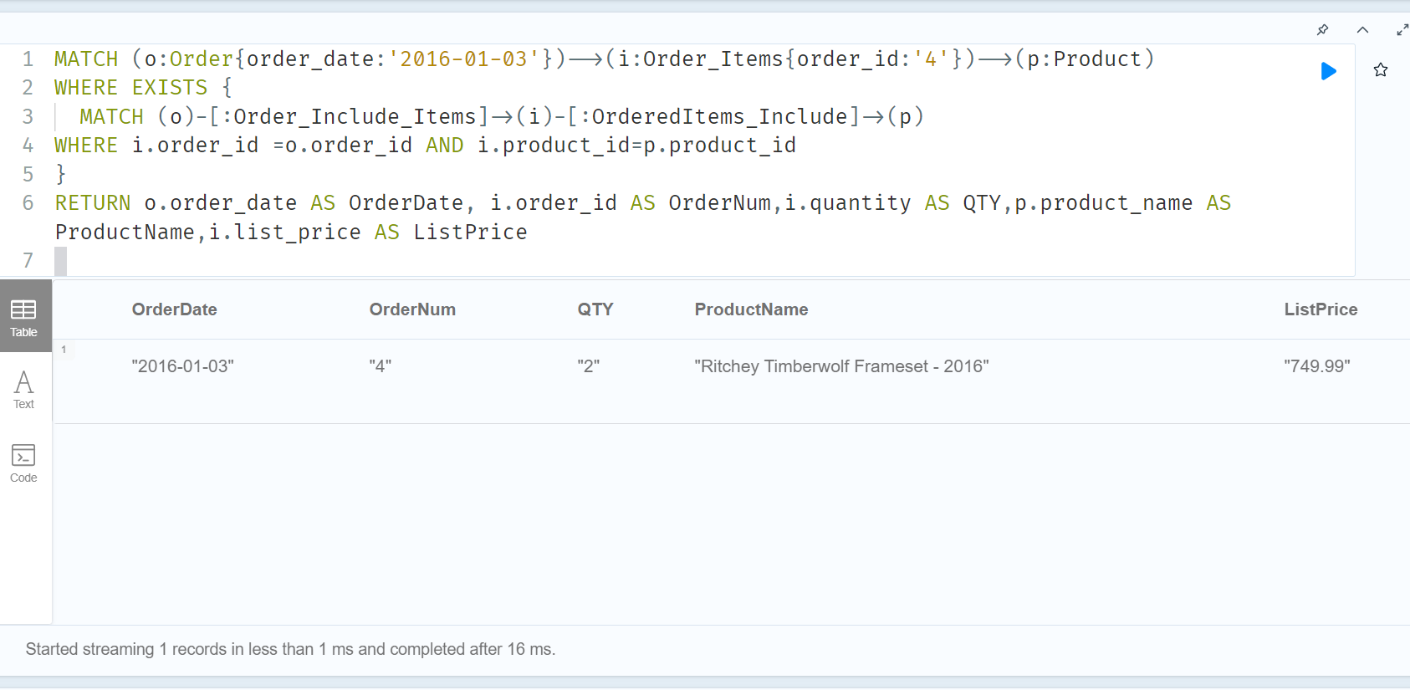
Neo4J Query 7
To retrieve the information about order_id e.g. ‘4’ when the order date is e.g. ‘2016-01-03’ about ordered quantity, product name and list price.

Slide 35
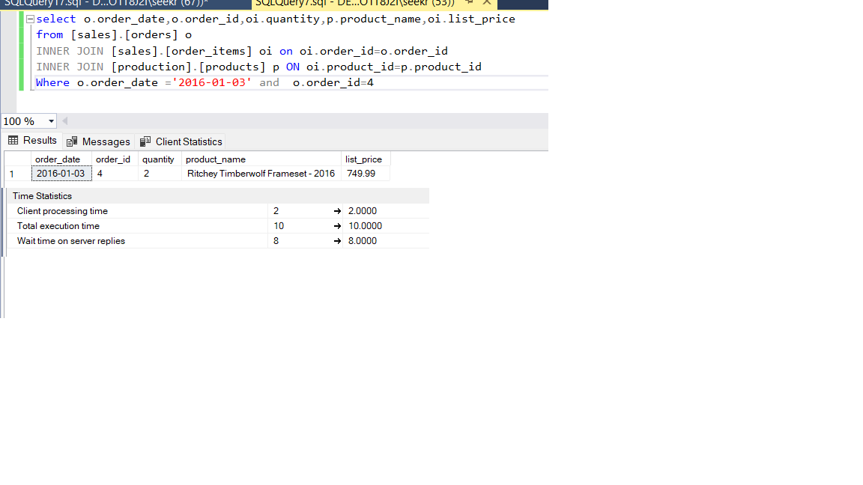
MS SQL Query 7
To retrieve the information about order_id e.g. ‘4’ when the order date is e.g. ‘2016-01-03’ about ordered quantity, product name and list price.

Slide 36
MS SQL vs Cypher
Queries | Execution Time (ms)
 | MS SQL Server | Cypher
Query 1 | 9 | After 1
Query 2 | 11.5 | After 1
Query 3 | 12.3333 | After 1
Query 4 | 14 | After 8
Query 5 | 27.5 | After 24
Query 6 | 4 | After 24
Query 7 | 10 | After 16

Slide 37
Conclusion
Graph databases, like relational databases, are:
ACID (atomicity, consistency, isolation, durability) compliant.
Both have no concept of aggregate ignorant.
(Lydon, 2022)

Slide 38
Conclusion
Relational databases have the problem that the application developers cannot clearly match the in-memory data structures to the relational tables (Lydon, 2022)
Also, relational databases are not suitable for running on the clusters of machines (Lydon, 2022)
This is solved by Graph Databases. If we compare ERD on slide 4 and Graph database schema on slide 24, we can clearly see the simplicity of Graph database.

Slide 39
Conclusion
Relational Database | Graph Databases Neo4J
Tables | Graphs
Rows | Nodes
Constraints | Relationships
Columns | Properties
Use of joins | No use of joins
Use of Schema | Schema free
Structured Data | All
Secure | No security
Less or no scalable | High scalability
ACID compliant | ACID compliant

Slide 40
References
Shaikh, M.M. (2013) ‘Create First Data Warehouse’, CodeProject, Available at:
http://www.codeproject.com/Articles/652108/Create-First-Data-WareHouse
Comparing SQL with Cypher’Neo4J Developer, Available at: Comparing SQL with Cypher - Developer Guides (neo4j.com)
Hunger, M., Boyd, R. and Lyon, W. (2016)’RDMS & Graphs: SQL vs. Cypher Query Languages’, neo4j, Available at: RDBMS & Graphs: SQL vs. Cypher Query Languages (neo4j.com)
Lydon, B. (2022), ‘On Demand Lesson 5 -NoSQL Databases: The Emergence of NoSQL’, B9DA111_2122_TMD3: Data Storage Solutions for Data Analytics. Dublin Business School. Available at:https://study.dbs.ie/2122/msc-data/B9DA111/Unit5/index.html#/lessons/KConnDRWyCDPTnj-mSGDRz2THNlFP4ab

Slide 41
Questions

